Slide 1
Introduction to Part II
HLL Structures
Variables
Activation records

Slide 2
Higher Level Languages
HLLs allow symbolic naming of variables
  After mastering Assemly, you can now appreciate what a luxury this is!
HLLs provide expressiveness
  Compare an if statement to a conditional Branch instruction!
HLLs abstract from the underlying hardware
  While each microprocessor has its own ISA, HLL code is usually portable between many different platforms
etc., etc.

Slide 3
Translation
HLL code has to be translated into the ISA of each machine it runs on:
  Interpretation:
    The HLL code is simply a set of commands for a program called an interpreter, which is a virtual machine that translates the HLL code a piece at a time into Machine Language, executes it on the spot, then goes back for another piece.
    Both the HLL source code and the interpreter are required every time the program is run.
  Compilation
    The HLL code is translated into an entire ML program (an executable image) by a program called a compiler.
    Only the executable image is needed to run the program.
    Most application software is sold in this form.

Slide 4
Variables
Symbolic names for variables
  The compiler creates a symbol table which holds information about each variable:
    Identifier (name), data type, memory location (as an offset from a “frame pointer”), scope, etc.
  Suppose a variable “seconds” has been assigned an offset of -5 from the frame pointer, which is maintained in R5: then we can access seconds by the Base+Offset addressing mode:
    LDR R0, R5, # -5
    i.e. each reference to the variable seconds is translated by the compiler to (R5) - 5
    We have finally found a use for the offset in LDR!

Slide 5
Activation Records
A Record
  A collection of contiguous memory locations treated as one entity
  The struct construct in C/C++ describes a record
Activation Record
  Is allocated for each function invocation in memory
  The area of memory where activation records are allocated is called the stack memory or run-time stack
  In LC-3, R6 is the stack pointer: it points to the top of the stack (TOS)
  R5 is the frame pointer: it points to the first local variable
  Each element on the stack is an activation record

Slide 6
Function calls
When a function call is made:
  The calle saves space on the stack for the return value
    this is located immediately on top of the callee’s parameters
  The callee pushes a copy of the return address (in R7) onto the stack
  The callee pushes a copy of the dynamic link (the callee’s frame pointer, in R5) onto the stack
  The callee allocates enough space on the stack for its local variables, and adjusts R5 to point to the base of the local variables, and R6 to point to the top of the stack.

Slide 7
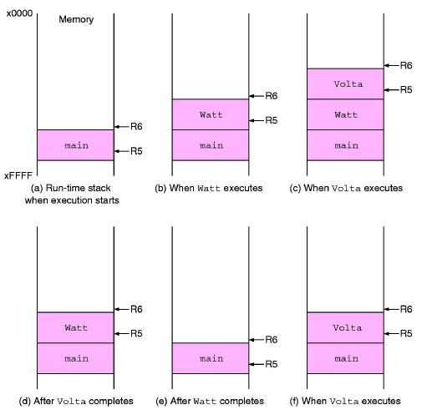
Main calls Watt, which calls Volta

Slide 8
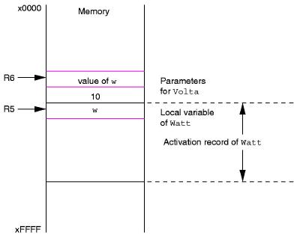
Watt prepares to call Volta

Slide 9
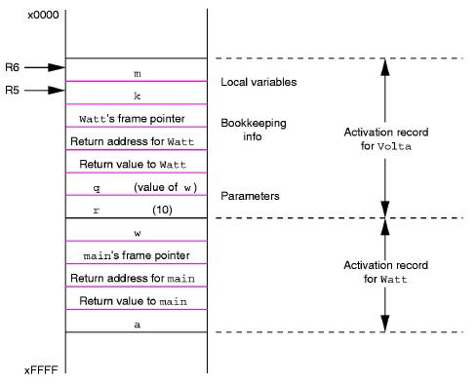
Volta is ready to run

Slide 10
Returning from a call
Ending the callee function:
  If there is a return value, it is written into the return value entry of the activation record
  The local variables are popped off the stack
  The dynamic link (the caller’s frame pointer) is restored
  The return address is restored (R7)
  The RET instruction returns control to the caller function
Returning to the caller function:
  The return value is popped off the stack
  The arguments are popped off the stack

